Slide 1
Lightning Talks
Week 1: The Problem & Users

Slide 2
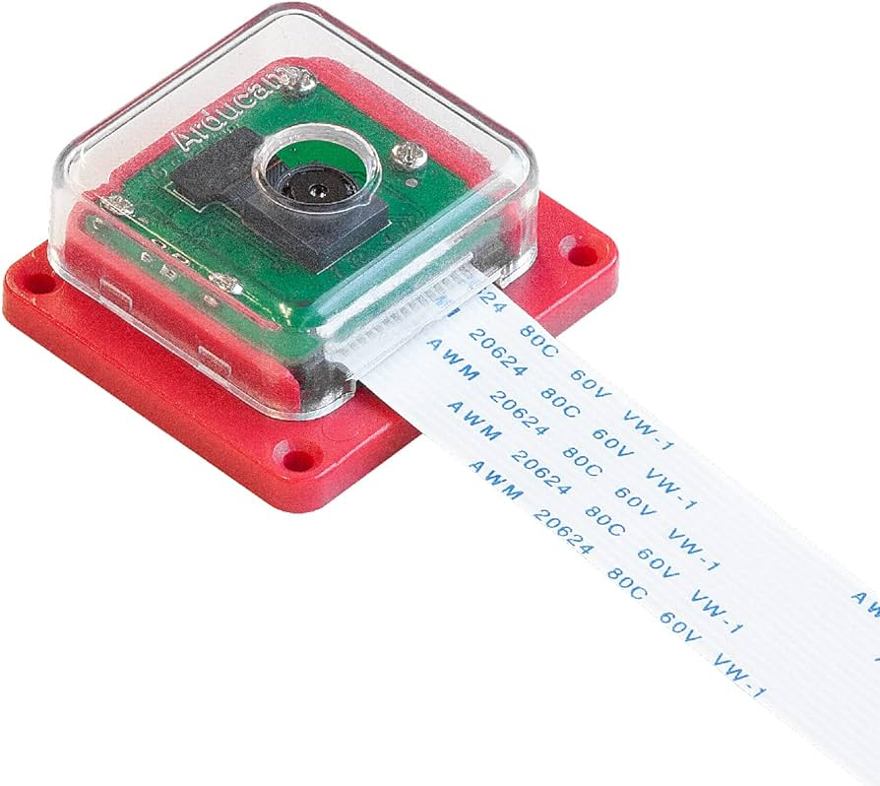
Project Overview
We will be developing a video pipeline from a MIPI-connected COTS camera module to a video monitor
The MIPI video data will be sent through a custom FPGA-based video pipeline
The augmented video will be sent to a monitor connected via an active displayport cable
The software will execute within a Linux operating system
STRETCH GOAL: Video may be passed into a machine learning algorithm and the output of the ML algorithm will be used to augment the video sent to the monitor

Slide 3
Function Requirements
Functional
The product will compute machine learning in real-time
Software that routes data will use a Linux image
The product will use C and Python code
The product will need to work in a variety of lighting conditions
Resource
The product will require a 12V power input
Physical
The product will use a Sony IMX219PQH5-C image sensor
The product will use an Ultra96-v2 FPGA board
The product will utilize off-the-shelf and open source components
User experiential
Output is sent through mini DisplayPort
Environmental
The product will take a video feed as input from the image sensor
The product will need to withstand wear and tear from normal weather conditions

Slide 4
Problem Statement
There are numerous applications for a computer vision pipeline that makes use of Machine Learning algorithms: from medical imaging to self-driving cars to surveillance drones. This project aims to create a proof-of-concept video pipeline using common off-the-shelf materials and software. The inspiration for this design comes from the desire to help disabled or injured individuals increase their quality of life by tracking their eye movements. These individuals can have inhibited fine motor skills that make acute navigation challenging, and individuals confined to a wheelchair often require a helper to perform daily living tasks. Capturing eye movements in real-time for these individuals will be vital in assisting them with their communication and navigational needs. This is just one application for this product which can be used in a broader range. For example, this product could be used as a ready set of components for a programmer to explore an interest in machine learning.

Slide 5
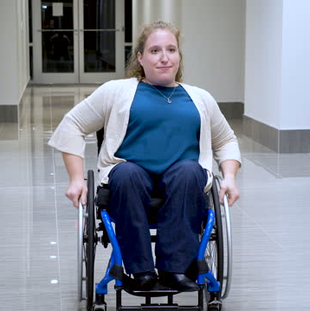
User 1: Ethyl
Characteristics
Has a disability and is wheelchair bound
Has poor fine and gross motor skills, is confined to a wheelchair, has difficulty performing daily tasks by themself, occasionally gets seizures
Hears
“There are certain tasks that you can’t do”
Says
“I want to be able to color inside the lines”
Thinks & Feels
Wishes they didn’t always need as much help
Wishes they could better communicate their needs
Pain
Medical problems limit the ability to perform daily tasks

Slide 6
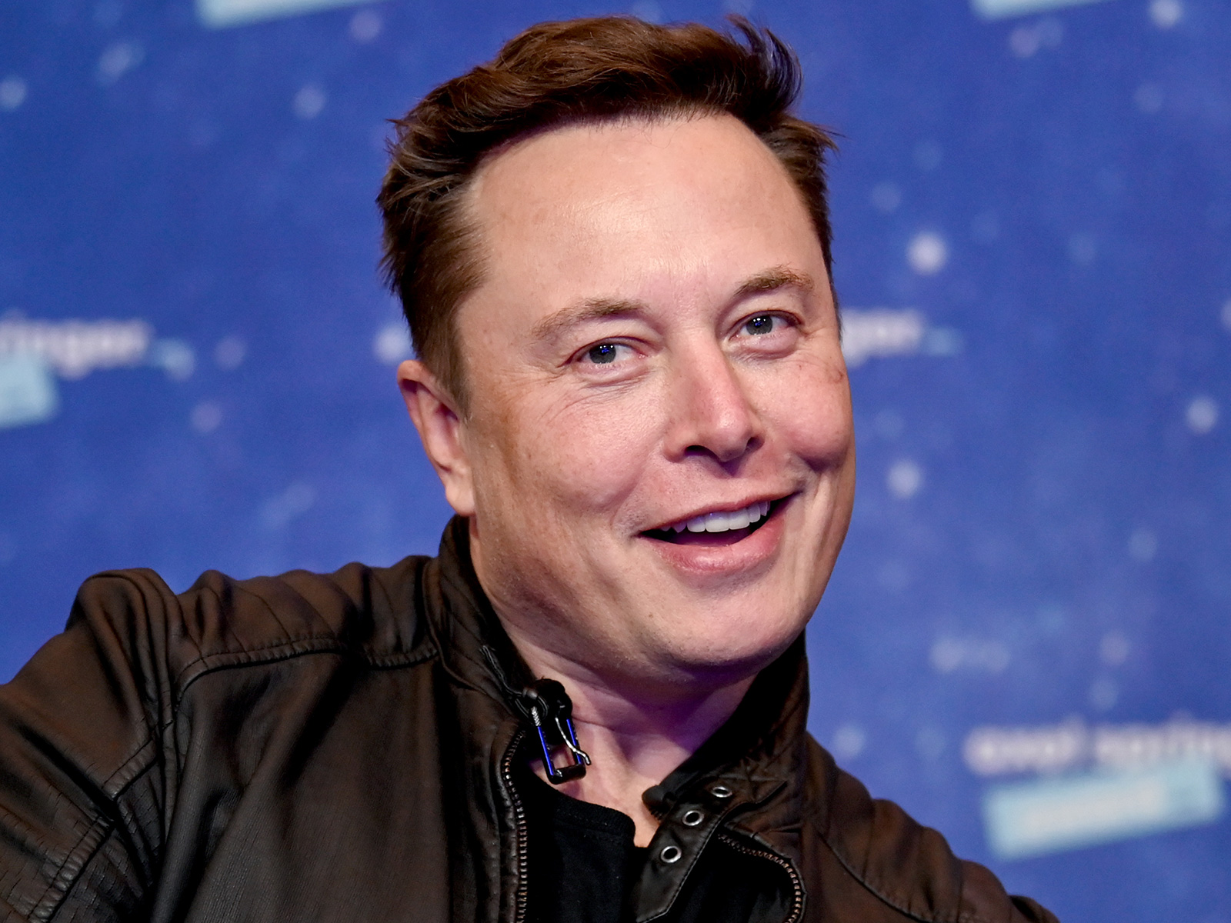
User 2: Elon
Characteristics
Enjoys computer programming and finding practical solutions to everyday challenges
Hears
Favorable reviews of ChatGPT, AI, and machine learning
Says & Does
“Why spend 5 minutes doing something manually when you can spend 8 hours automating it”
Thinks & Feels
Tired of wasting time when computers can do the job instead
Pain
Requires a lot of research and fine-tuning

Slide 7
User 3: Nurse Jackie
Characteristics
May not be very tech-savvy or up to date with recent technological trends (like ML) and is open-minded to new ways of helping their patients
Sees
Maybe they have difficulty seeing and need a computer to help out
Thinks & Feels
Machine learning and AI are the future
Says & Does
Look for ways that new technology can help people in need
Pain
Seizures can occur and medical staff need to be notified ASAP

Slide 8
User Needs
Ethyl needs a way to consistently navigate and perform her daily tasks without risk of injury or fatigue because she has limited fine motor skills due to her disability.
Nurse Jackie needs a more effective and efficient way of taking care of their patients that is easy to learn so that they can have more time to take care of multiple patients at the same time.
Elon needs a device that easily processes video data for machine learning applications because he wants to create an innovative product.

Slide 9
Conclusion
This product implements a video pipeline for machine learning that has a wide range of applications. Users could range from anyone in need of medical imaging to drone surveillance to someone with an interest in machine learning. All of which, users will need a camera that works in real-time and in a variety of lighting conditions. Our project is inspired by the needs of disabled or injured individuals with the goal of improving their quality of life through tracking eye movements to assist caretakers with identifying a disabled/injured individual’s communication and motor skill needs.

